Slide 1


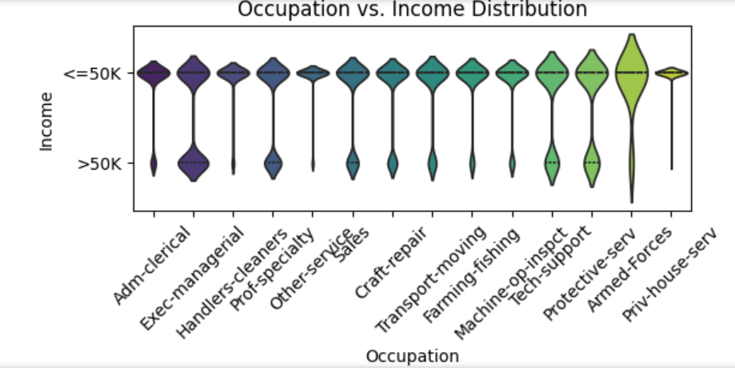
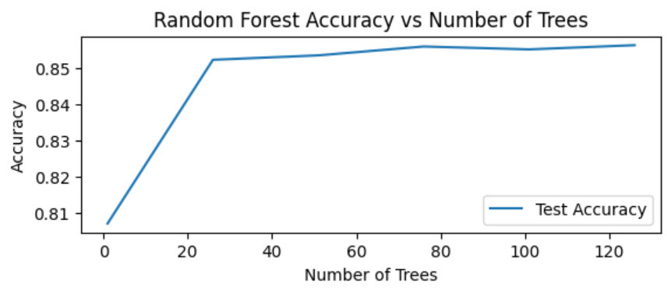
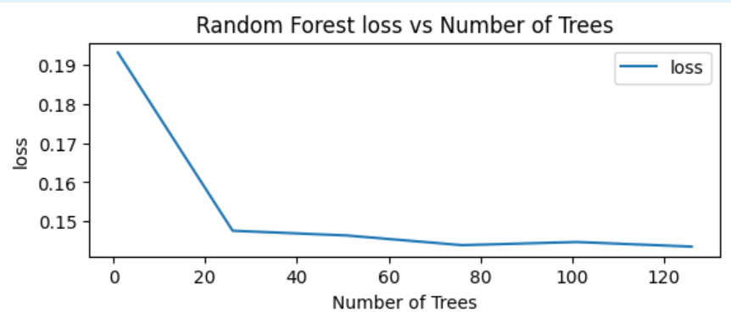

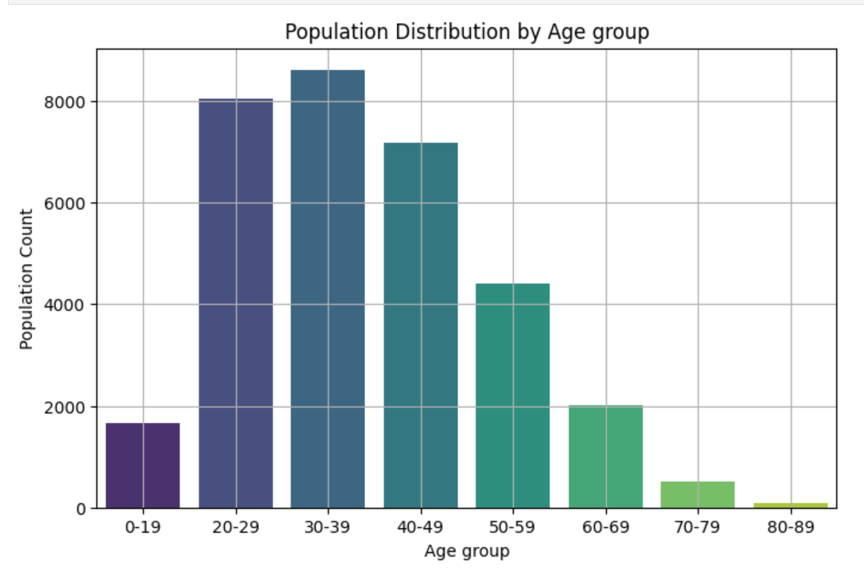


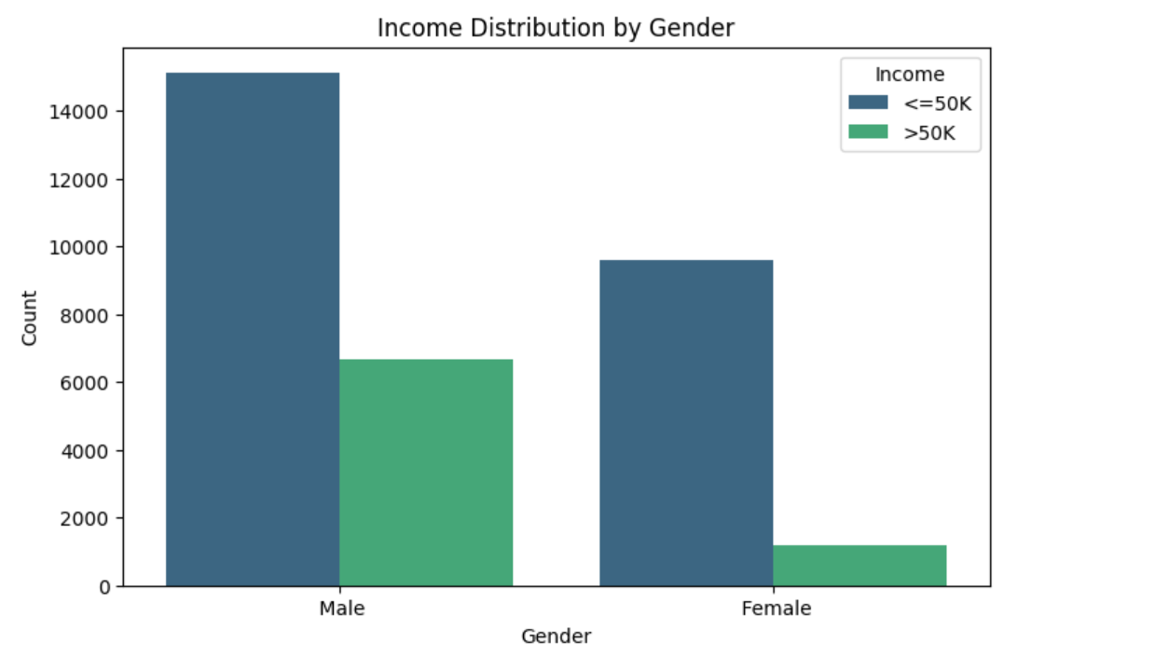
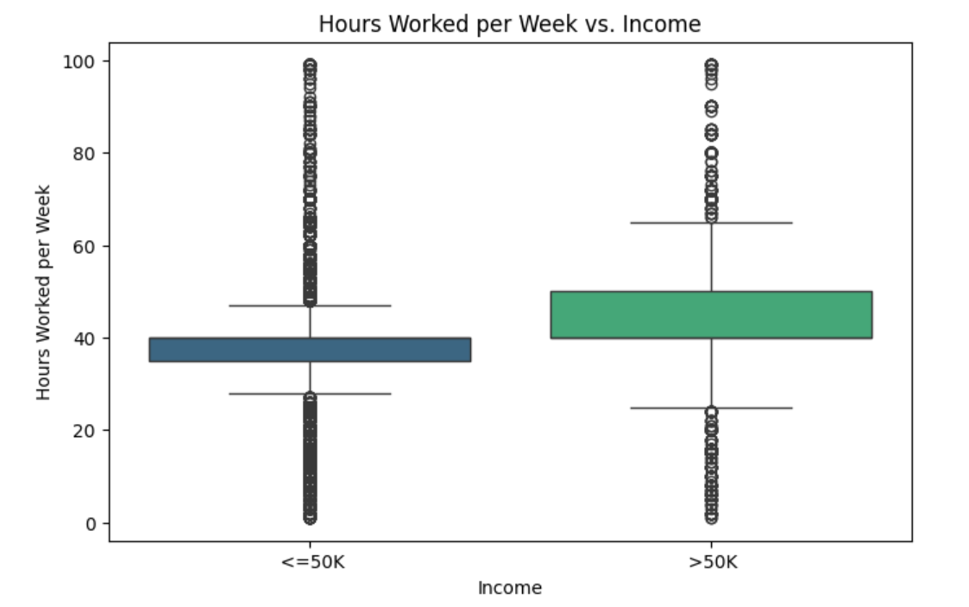
INCOME PREDICTION USING MACHINE LEARNING
Prathibha Vuyyala
Introduction
In this project, I aimed to predict whether an individual earns more than $50K annually using data from the UCI Adult dataset. This analysis provides insights into income inequality and helps identify factors that influence higher earnings. I performed data cleaning , EDA and used ML models for predictions to achieve high accuracy.
Data Analysis (EDA)
The dataset was explored using visualizations to understand the relationships between demographic features like age, gender, and income levels.
The bar plot highlights a majority in the 20-39 age range, reflecting the dataset's focus on working-age adults.
The plot shows income inequality, with more males earning >50K and a higher proportion of females in the <=50K group.
The box plot shows that those earning >50K typically work more hours, suggesting a link between longer hours and higher income.
Methods
The dataset was preprocessed to handle missing values, remove duplicates, encode categorical variables, and prepare it for modeling.
Data loading and Preprocessing
The dataset was loaded into a Python environment using the pandas library.
Missing values were handled by imputing them with the most frequently occurring values in each column.
Duplicate rows were identified and removed to ensure data integrity and avoid bias in the model.
Encoding Categorical Variables
Ordinal Encoding was applied to the sex and income columns, as these contain a clear order of categories (e.g., Male/Female and <=50K/>50K).
Nominal Encoding was applied to other categorical columns (e.g., education, marital status, occupation) using one-hot encoding to convert them into numeric format suitable for machine learning models.
Predictive Modeling
A Random Forest Classifier model was trained to predict whether an individual earns more than $50,000, using feature scaling to enhance model performance.
The dataset was split into features and the target income column, and the model was trained with 100 decision trees (n_estimators=100) for better accuracy.
After training, predictions were made on the test data, successfully classifying individuals based on their income levels.
Conclusion
The Random Forest model performed well in classifying income levels, achieving high accuracy and providing valuable insights into income inequality.
The model achieved an accuracy of 85.47%, effectively predicting income based on demographic and employment factors..
While the model performed well overall, it struggled slightly with higher-income predictions, suggesting areas for future enhancement, such as incorporating more features.
Results
The Random Forest model achieved a solid 85.47% test accuracy, performing well for lower-income predictions (Precision: 0.88, Recall: 0.93) and showing decent results for higher-income predictions (Precision: 0.73, Recall: 0.61).
As more trees were added(refer Figure E), the model's accuracy improved and error decreased, showing strong learning and reliable income classification.
Figure D:
The violin plot shows higher-income roles like executives have more >50K earners, while lower-paying jobs like cleaners mostly earn <=50K, reflecting income disparities across occupations.
References
Becker, B. & Kohavi, R. (1996). Adult [Dataset]. UCI Machine Learning Repository. https://doi.org/10.24432/C5XW20.
Department of Engineering Science – Data Science University at Buffalo
pvuyyala@buffalo.edu

